Slide 1
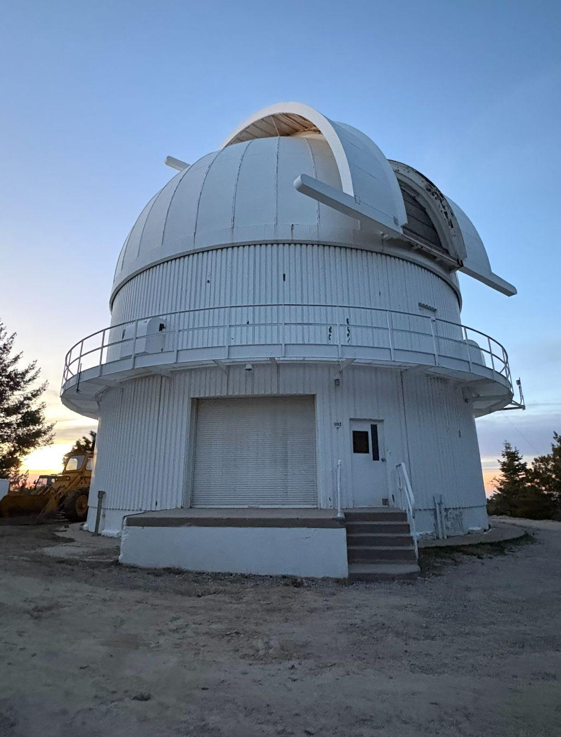
Pulsation of a Subdwarf B Star
ASTR 302, SPRING 2026
Zach Haarz, Lauren Jones, Thomas Nguyen, Ava Anderson

Slide 2
Introduction
Through observing the light curve and periodogram of a subdwarf B star, we will be able to mold the data into a format that allows us to derive the pulsation frequencies we observe. The short-period of our target star makes it an attractive candidate for being able to get a large number of pulsation periods over just one night of observing. Through this program, we observe the p-modes of a subdwarf B star to further understand the asteroseismological processes of the star through comparison with existing test data and other stars within the field of observation.

Slide 3
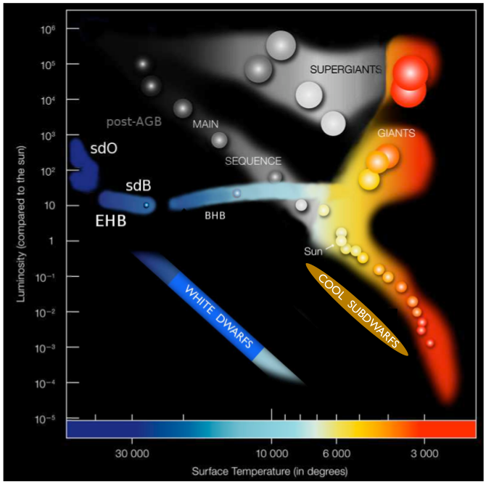
What is a subdwarf B star?
Burn helium at their core
Blue end of the horizontal branch
Kappa opacity mechanism
as opacity increases with temperature (opposite to what occurs in normal, non-pulsating stars) the star becomes unstable pushing it to where it will then pulsate causing the period we are able to observe
Areas where pulsations are excited are called instability strips
Image Credit: Annual Review Astronomy & Astrophysics.

Slide 4
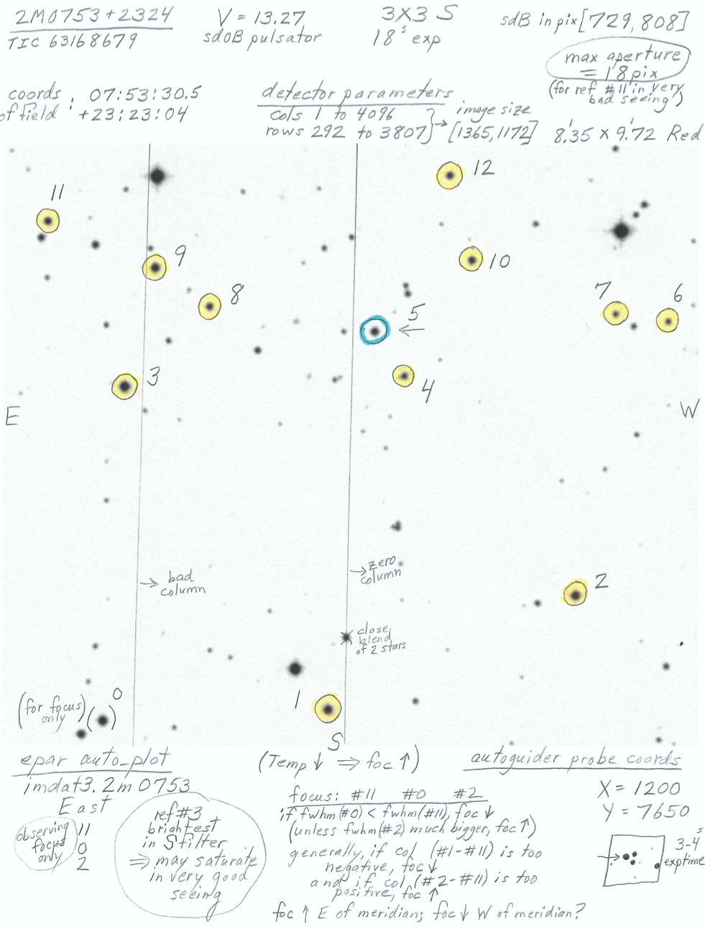
Target Information
Object Name: 2M0753+2324
RA and Dec: 07:53:29.1 +23:24:36
V Magnitude: 13.27
Object Type: Pulsating sdB star
Viewing Time: March 6-7th ~7pm-11pm (cut short by cloud coverage)
Telescope: The Steward Observatory 61” Kuiper Telescope
Mt. Bigelow, Tucson, AZ
Finder chart provided by Dr. Green

Slide 5
Methods/Observations
→ By studying how brightness changes over time, more specifically within the pulsation periods of the star we observed, we use the data gathered to make a periodogram. Observing the light curve allows us to analyze p-modes of the star giving us more information on the stellar structure and/or asteroseismology involving this star.
Steps to reduce data and obtain light curve
Image reduction through flat fielding and bias subtraction
Cosmic ray removal (proved unnecessary through recommendation of Dr. Green)
NOTE: always a good precaution to take
Photometric data reduction
Obtain Lomb-Scargle periodogram

Slide 6
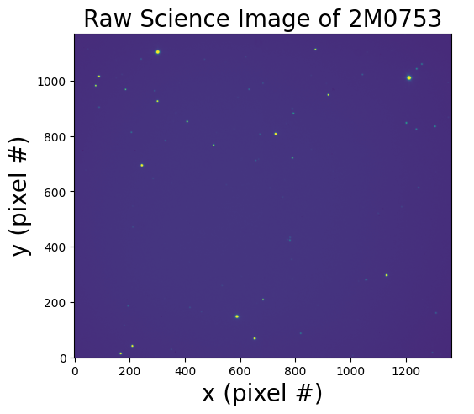
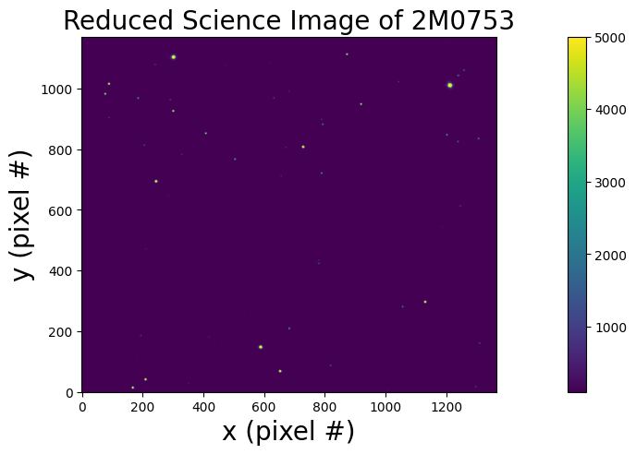
Pre- and Post-Reduction Starfields

Slide 7
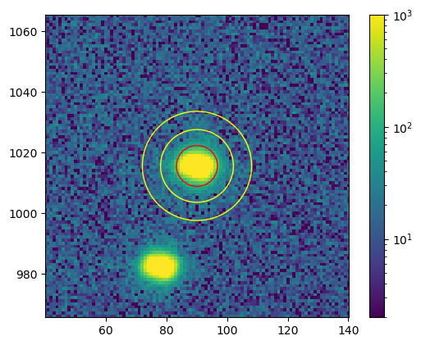
Data Analysis and Photometry
High-brightness pulsating variable target star, large number of dispersed reference stars, atmospheric noise: relative photometry
Co-wrote 3 pipelines for cross-consistency and implementation of different techniques:
Heuristic or optimized aperture parameters?
Sources of noise?
How should we extract frequencies?
Final result is Lomb-Scargle (mildly irregular observations) periodogram of normalized relative stellar flux
Y (pixel #)
X (pixel #)

Slide 8
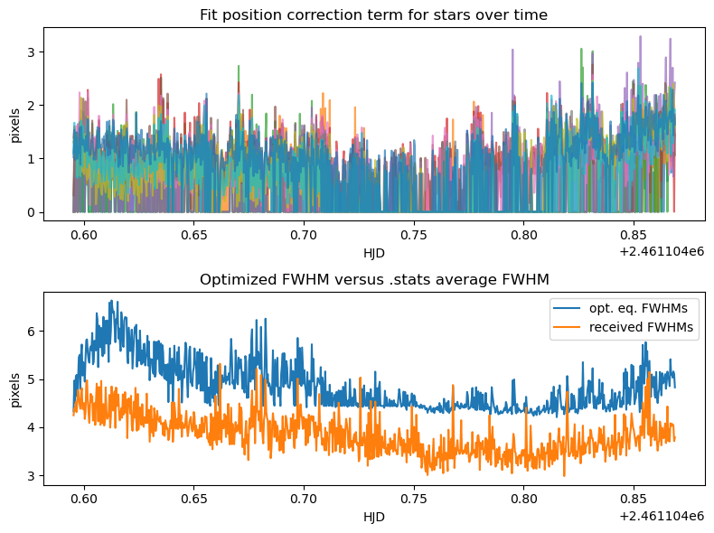
Can We Trust Our Heuristics?
We have a theoretical stellar pixel position for each circled star in our finder chart and average calibratory FWHMs from our observing run - we implement a recommended aperture radius of 2.25xFWHM, but are these accurate?

Slide 9
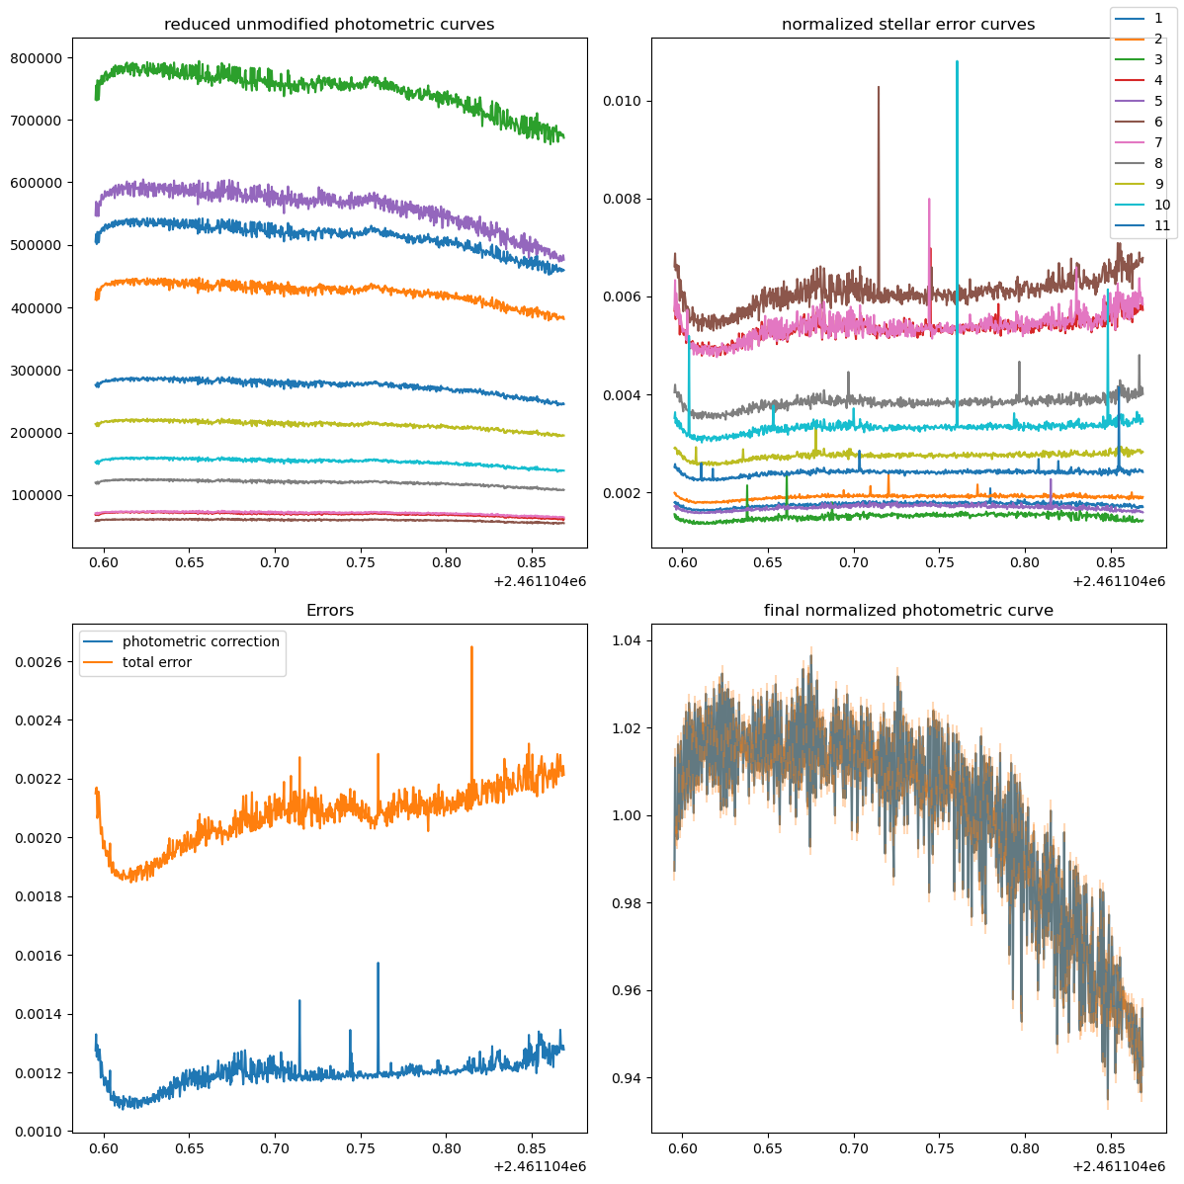
How Good is our Flux Resolution?
Fractional (Normalized) Flux
HJD
HJD

Slide 10
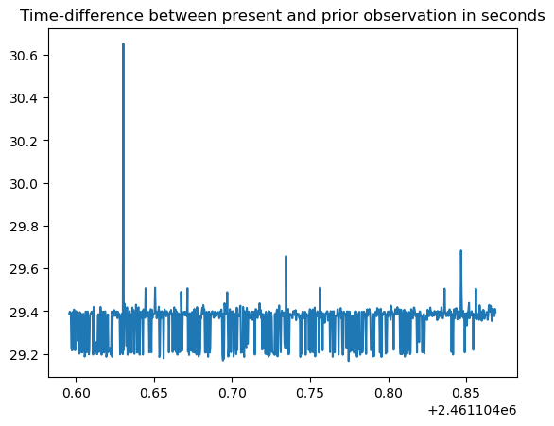
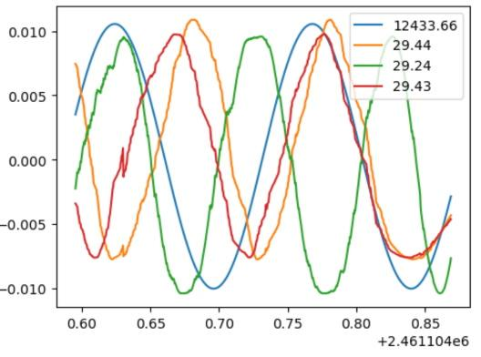
What is the Quality of our Frequency Data?
Irregularly sampled data can extract frequencies far in excess of the expected nyquist frequency for an equivalent Fourier transform (up to the LCM of every spacing between every data point), but has worse-defined errors and confidence. Our data is likely pseudo-periodic (in terms of aliasing and accessible frequency space constraints)
Time Differential (s)
Fractional Amplitude
HJD
HJD

Slide 11
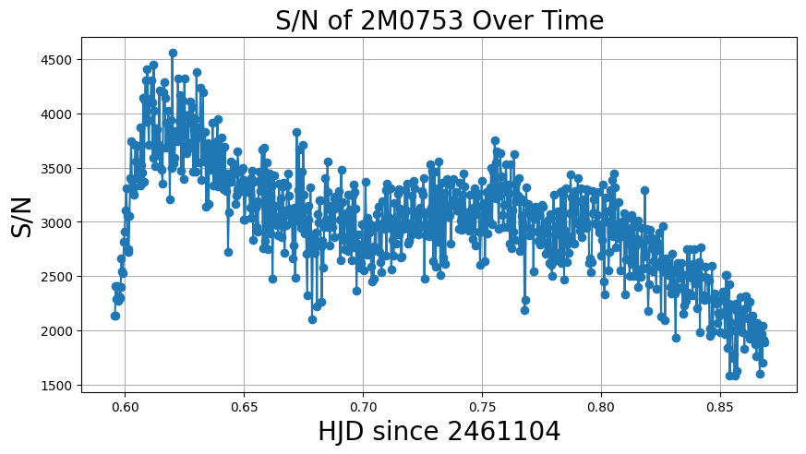
S/N of Target Over Time

Slide 12
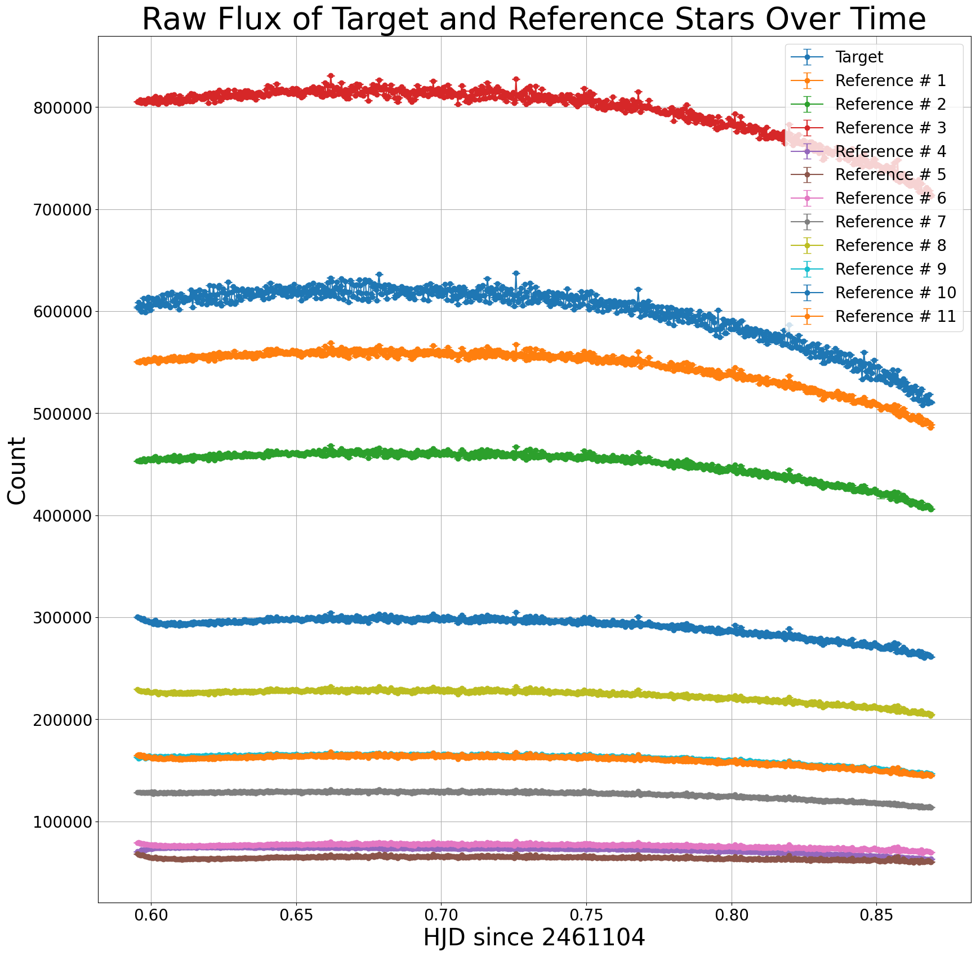
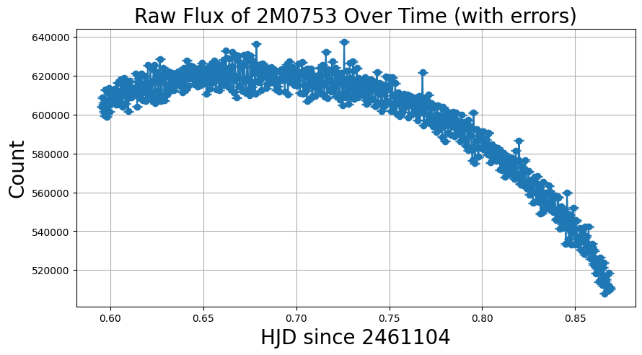
Raw Light Curves

Slide 13
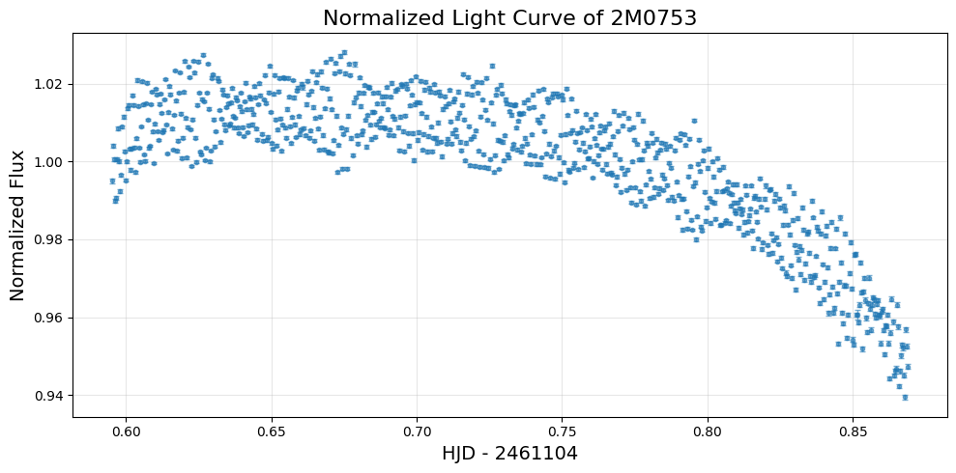
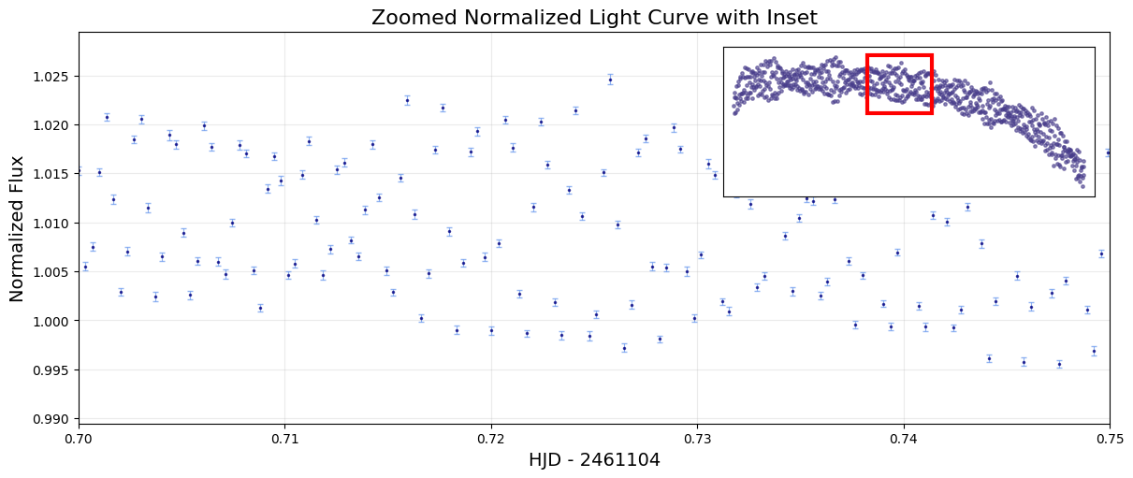
Normalized Light Curve

Slide 14
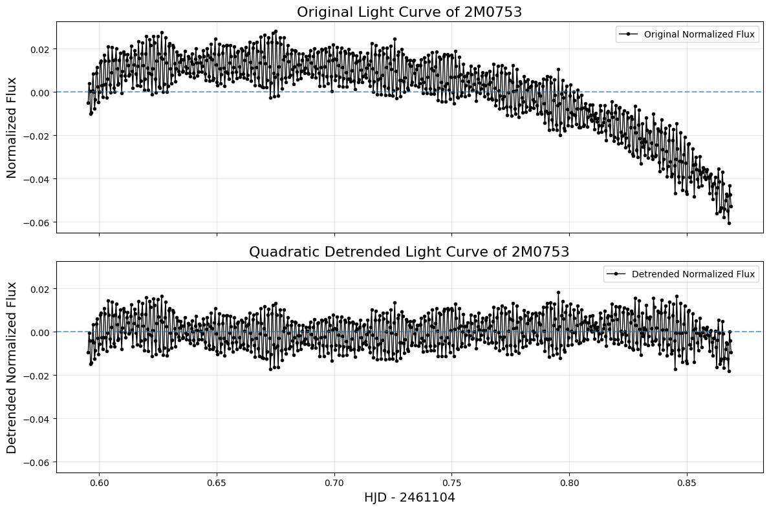
(Detrended) Normalized Light Curve

Slide 15
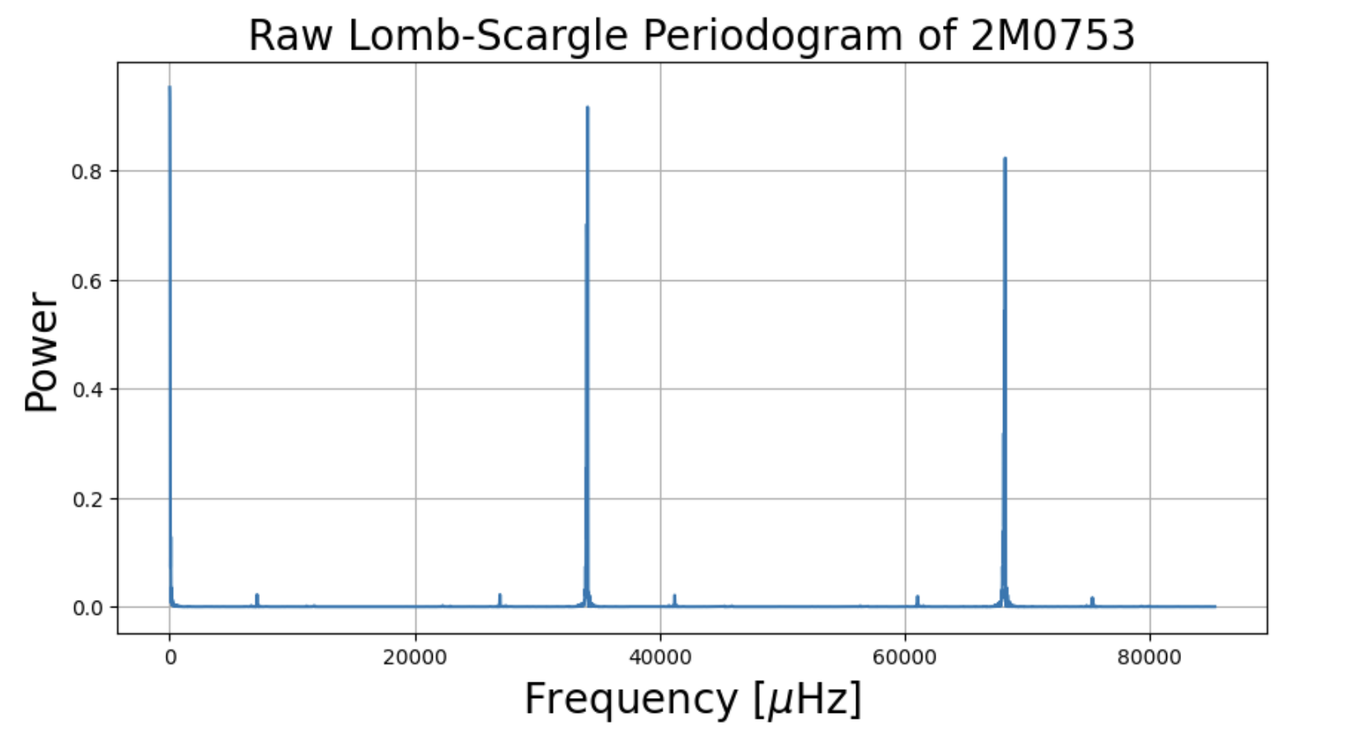
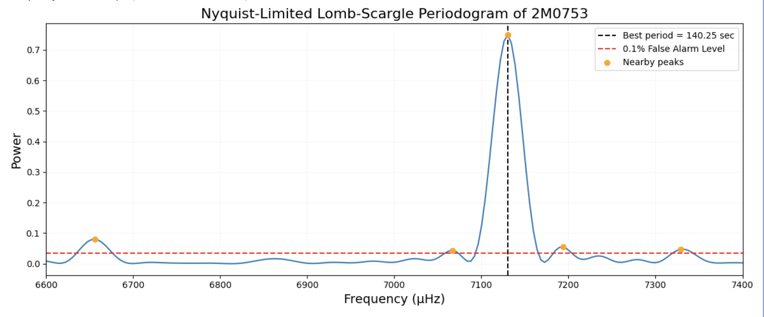
Periodograms
Raw Periodogram
Many peaks, including above cut-off frequency
High-frequency signals are not physically reliable
Strong 1 cycle/day peak is leftover trend
Nyquist-Limited and Detrended
Restricted to physically meaningful frequencies
Periodogram becomes much cleaner
Clear dominant peak at ~7130 µHz (~140 s)

Slide 16
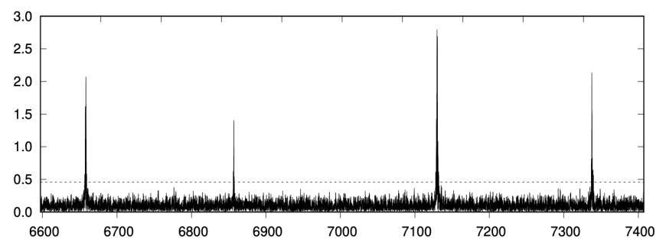
Periodograms Continued
Comparison to Paper:
Paper finds multiple modes (135–150 s)
We detect strong peak at ~140 s
Smaller nearby peaks → likely unresolved modes
Sanity check data split:
Two mini periodograms
First half main peak: 140.31 s
Second half main peak: 140.23 s
(Periodogram from “Short-period pulsating hot subdwarf stars observed by TESS”, Baran et. al)

Slide 17
Thank you!
….and May the fourth be with you.

